Slide 1
Automated LLM Report Generation
Task:
Build a lightweight prototype LLM-powered workflow to generate a business report with reproducible structure and coverage when run on the same dataset. The report is expected to contain plots and narrative insights.
On simulated BMW sales data (2020-2024)
Leroy Ee

Slide 2










Approach
(Eng)
Clean, Easy to Read Code
Function and Document level docstrings for readability
Descriptive variables, short functions
Comments communicate intent rather than describing the code
Pytested code
Configurable
Pipeline and node behaviour togglable via config files
Clear Documentation
Clear instructions for using the repository
Clear Organization
Files appropriately located in Kedro boilerplate config, src, data, test and other folders
Python files divided into sections for clarity
Managed Dependencies
Easily manage dependencies with PDM
Tech Stack
Project Framework
Testing Framework
Dependency Manager
Data Analysis and
Manipulation
If I managed to finish SQL Agent and
Evaluation Framework
Environment Variables
Data Visualization
SQL toolkit
Large Language Model

Slide 3
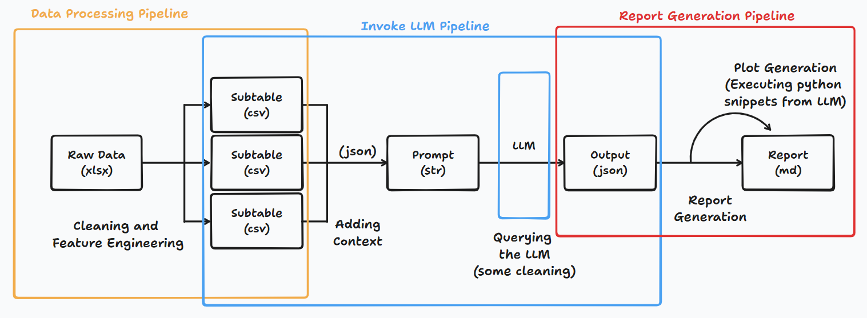
Approach
(DS)
Main Idea
Inject data (json) into the prompt (str) of an LLM which outputs a json that can be used to generate plots and the report.
Performed initial Exploratory Data Analysis to get a better understanding of the dataset and an idea of what the LLM is supposed to pick up.
Feature engineered aggregate sub-tables of the main data table were created in an effort to reduce the number of tokens required for this method.
Lightweight

Slide 4
Data Processing
Pipeline
Features
Checks for missing values in case data is incomplete. Highlights in the report if it is past acceptable levels.
Calculate important columns of interest like fuel efficiency and revenue.
Bin “continuous” numeric features into classes for easier aggregating
Drop rows without target columns (sales volume and revenue) as they don’t provide useful information.
Data Processing is important in this approach as the data is large would contribute to large token use. Summarized statistics are sufficient for insights

Slide 5
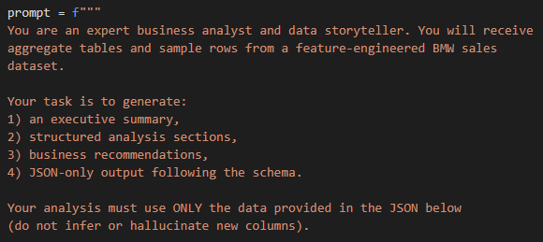
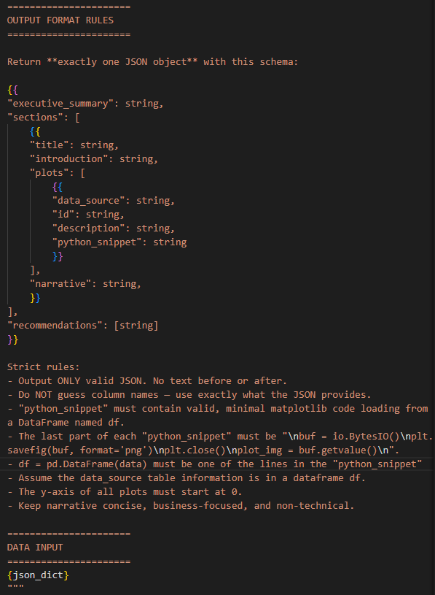
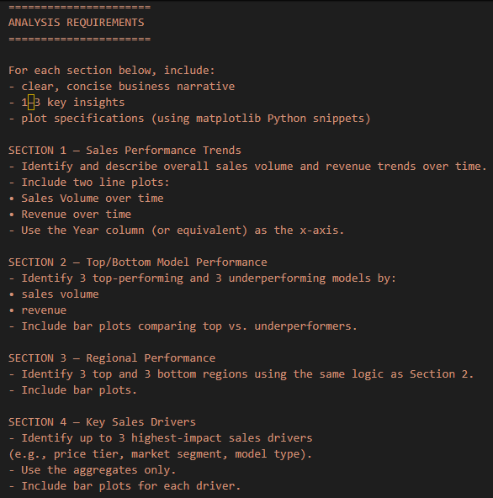
Invoke LLM
Pipeline
Prompt Engineering
Set the role of the LLM
Provide clear task instructions
Requested structured output format (JSON)
Provided schema of the output format
Provided structured data (context)
Named data input for each sub-table
Single Prompt

Slide 6
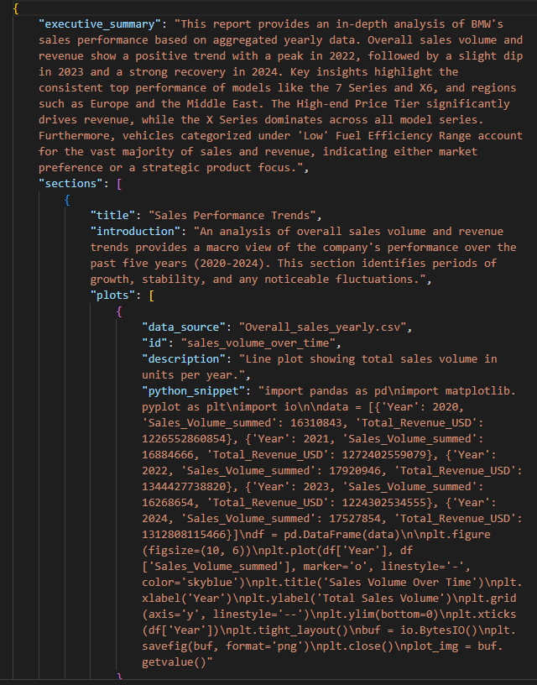
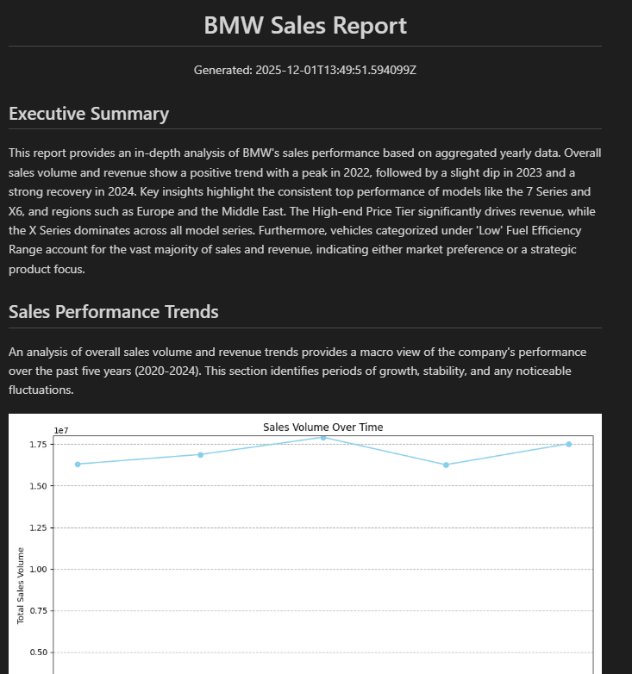
Generate Report
Pipeline
Structured output allows for easy isolation of each section.
Executes python snippet found in LLM output to generate plots.
md Report generated from output json

Slide 7
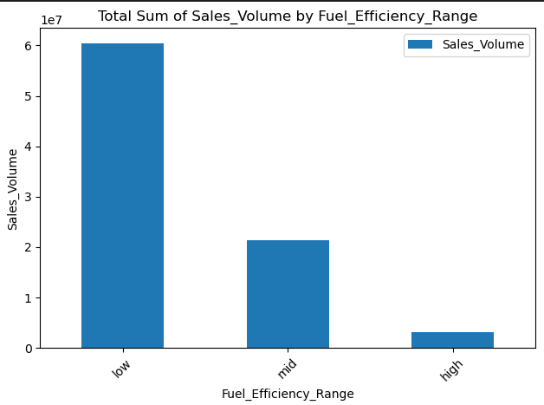
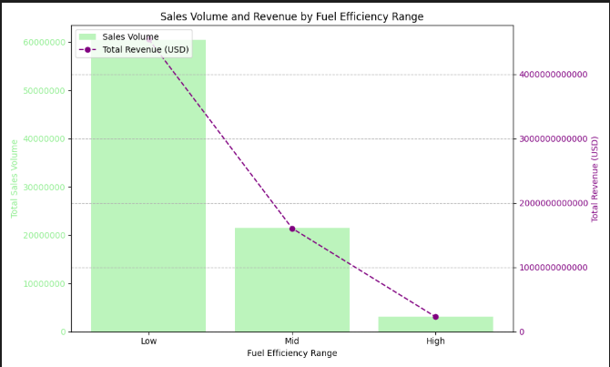
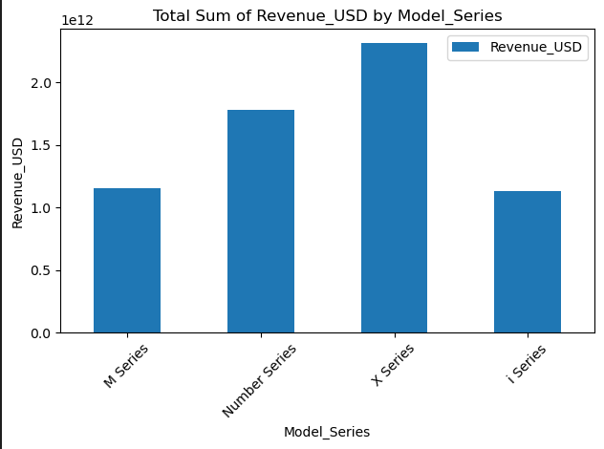
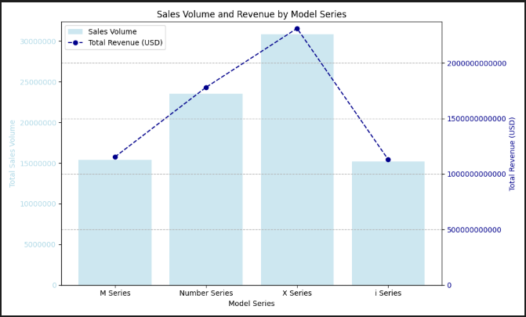
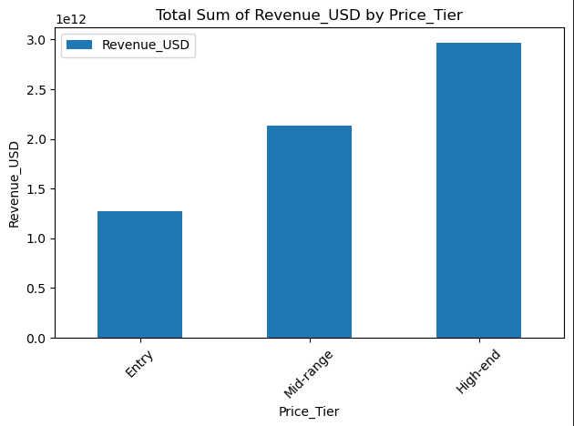
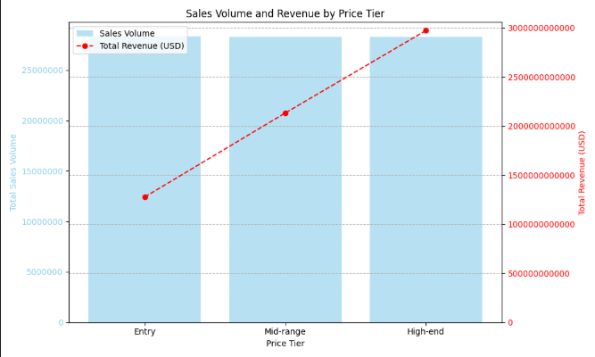
Results
Generated report highlights similar findings during EDA. It also managed to choose the features that showed the largest differences in sales volume and/or revenue when tasked to highlight key sales drivers.
*Might need to refine the prompt regarding choice of colour.
LLM output able to follow json structure consistently but “python-snippet” when executing code for plotting graphs have a chance to fail. To continue to explore other methods or regenerating framework.

Slide 8
Given more time…
I would implement
Regeneration Mechanism for when the LLM produces an inaccurate output
Try SQL RAG Agent
  Should use fewer tokens than current approach
  May be able to arrive at deeper analyses
Ragas evaluation
Docker containerization
Further refining the prompt
Improve report formatting

